Slide 1

HR Data Analysis
Psyliq Internship Project
Using MS - Excel And
Power BI
By Geetanjali Saxena

Slide 2
Introduction
The given HR (Human Resources) dataset contains a wide range of information related to employees within an organization.
This project is an attempt to leverage the capabilities of Excel and Power BI in transforming raw data into actionable intelligence.
The project’s learning objectives include data cleaning, processing, importing data into Power BI, data visualization, and creating a comprehensive HR dashboard. It highlights the use of measures, custom columns, and advanced DAX calculations for in-depth analysis.

Slide 3
Using Excel, how would you filter the dataset to only show employees aged 30 and above
Selected the Age column and applied the number filter with the criteria of age>=30.
Resulting table is shown in the next slide

Slide 4
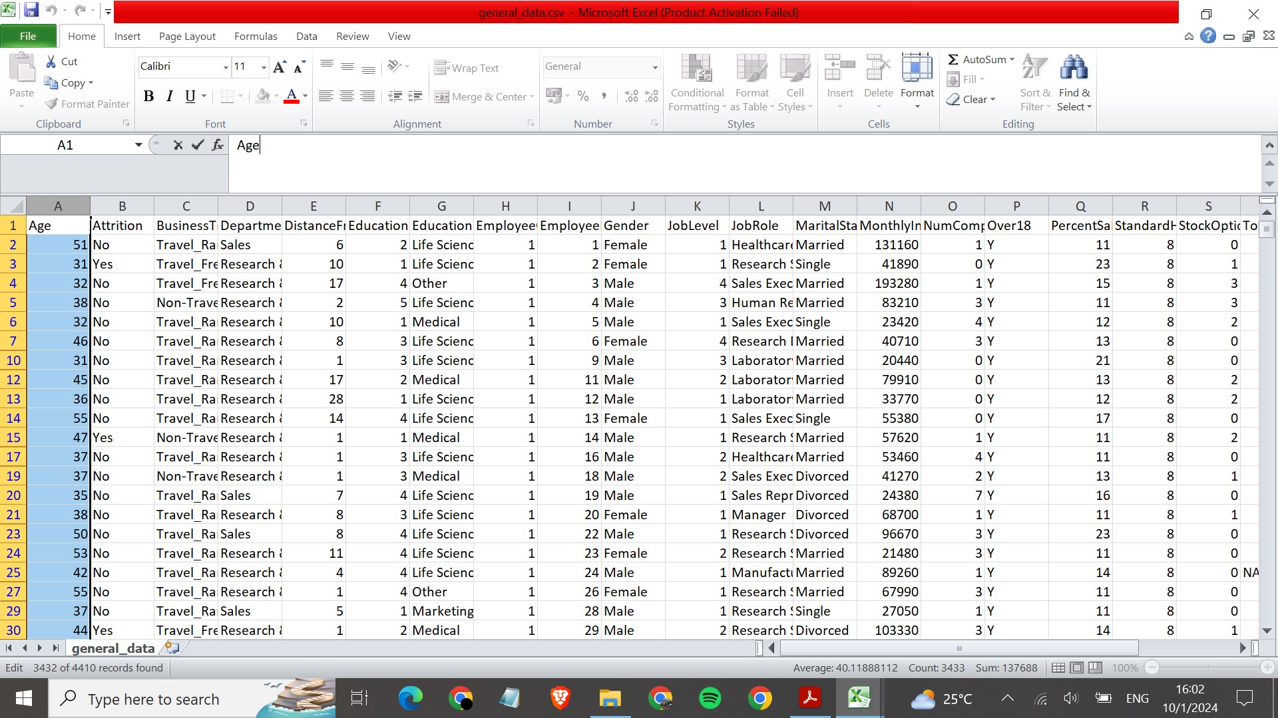

Slide 5
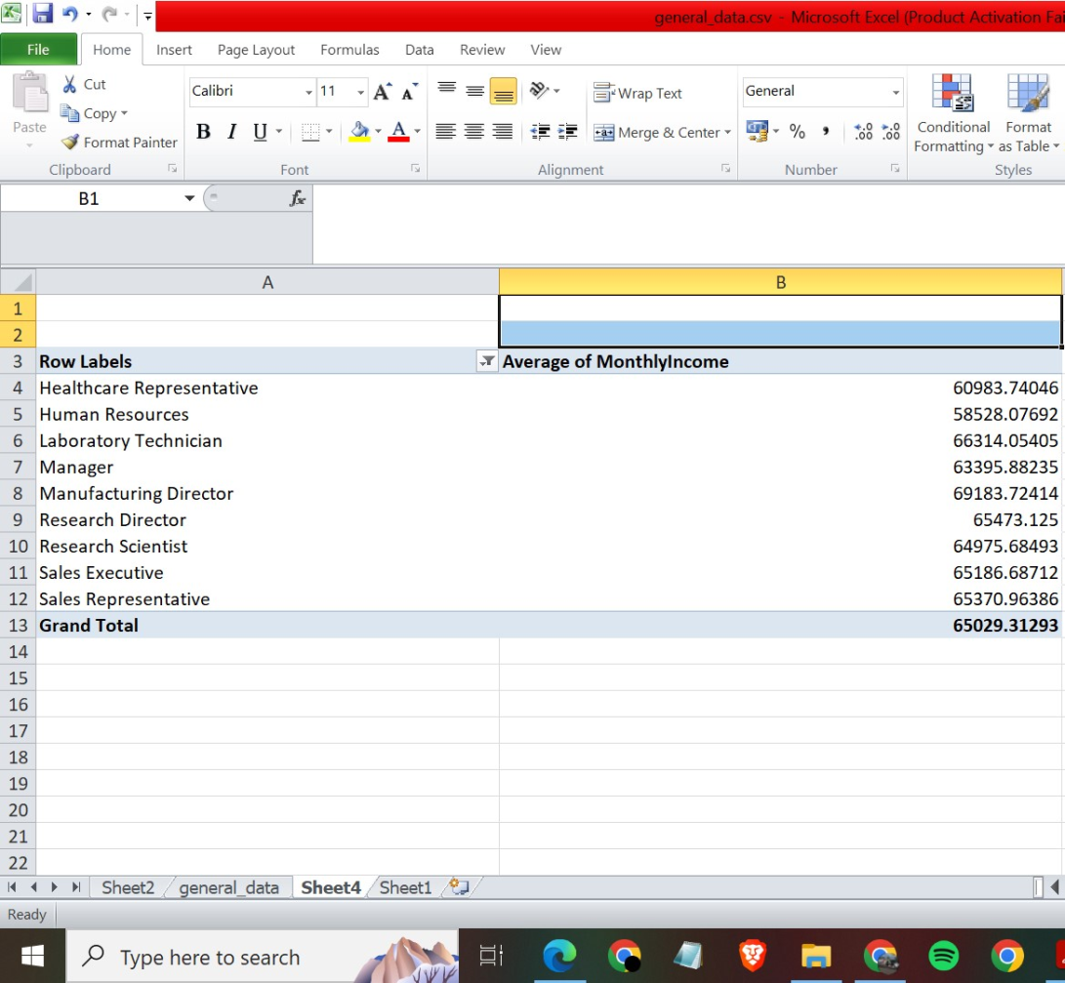
Create a pivot table to summarize the average Monthly Income by Job Role.

Slide 6
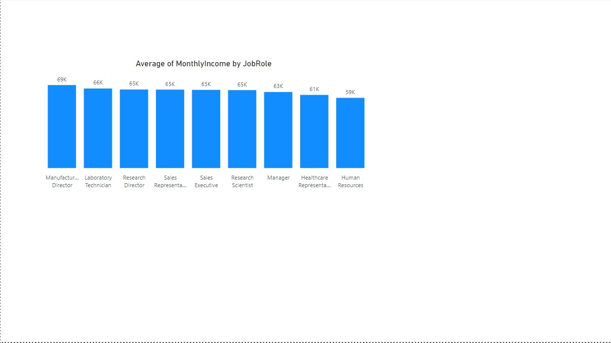

Slide 7
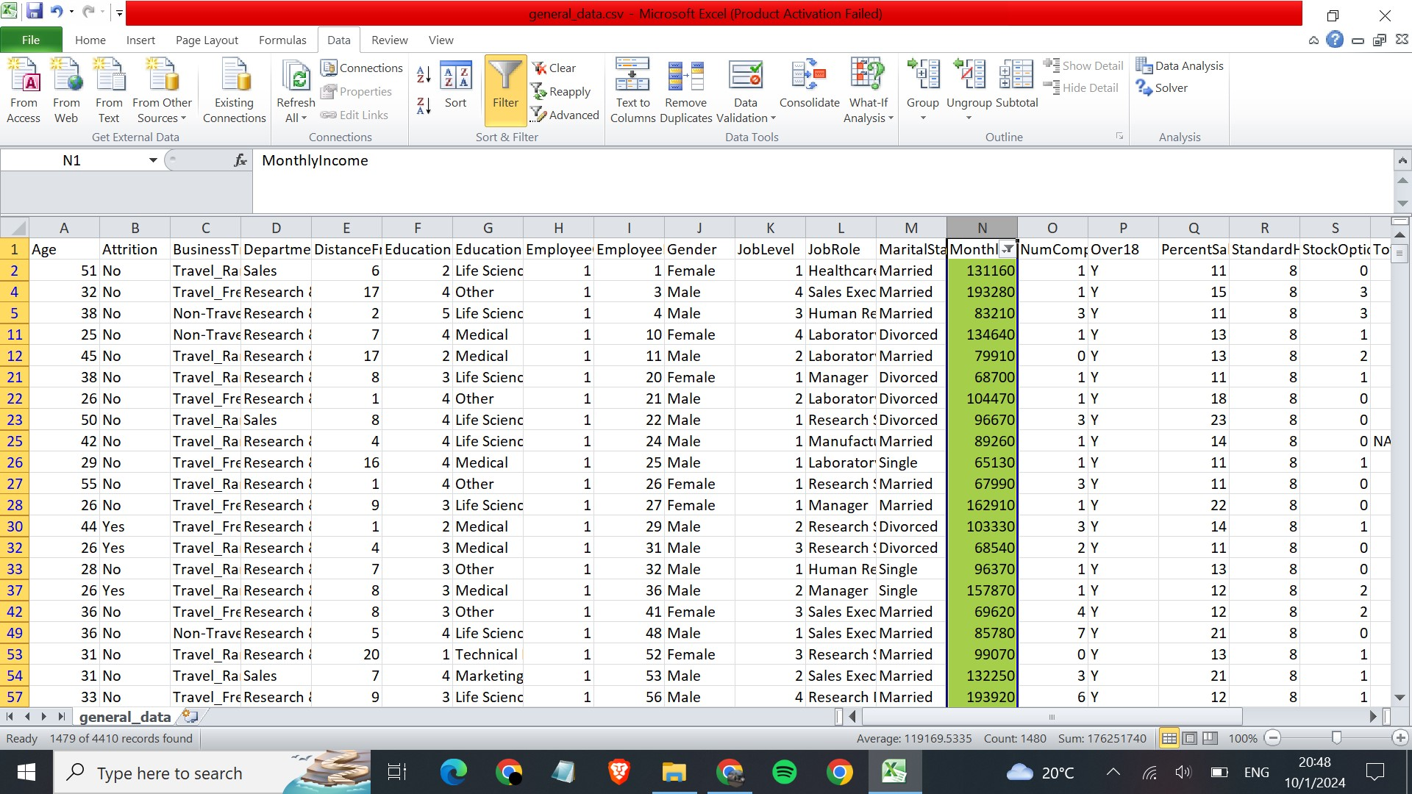
Apply conditional formatting to highlight employees with Monthly Income above the company's average income.

Slide 8
Create a bar chart in Excel to visualize the distribution of employee ages.
 | Age | Count
 | 18-20 | 84
 | 21-30 | 1074
 | 31-40 | 1857
 | 41-50 | 966
 | 51-60 | 429

Slide 9
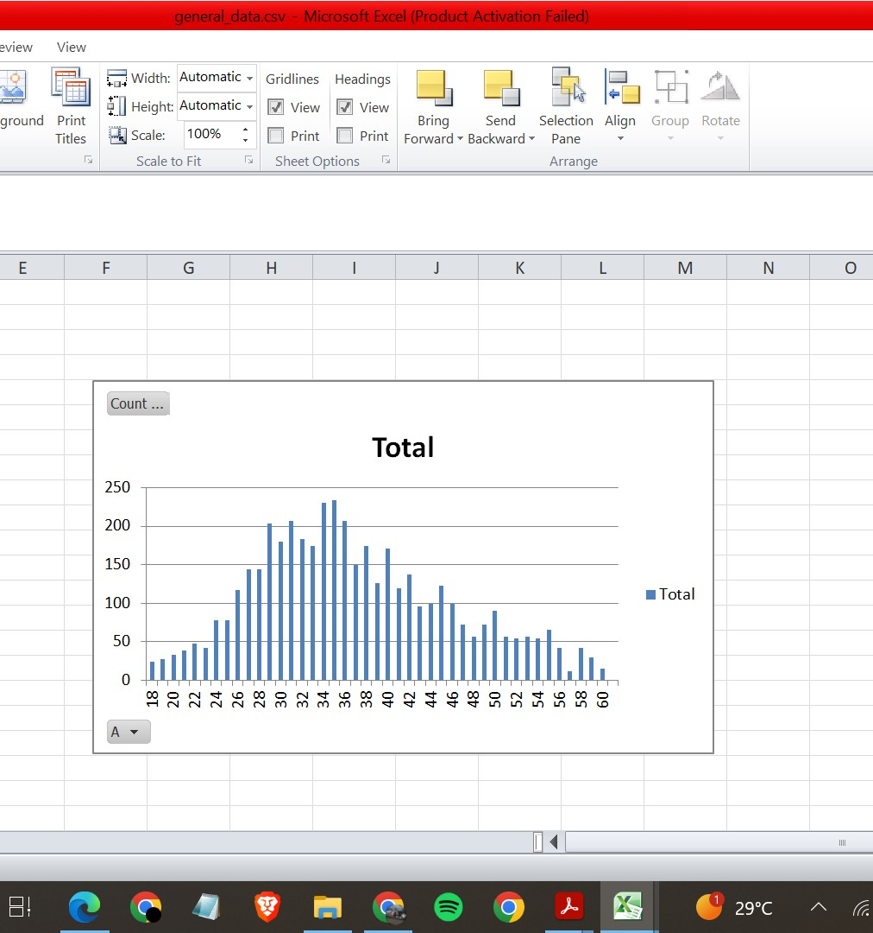
Create a bar chart in Excel to visualize the distribution of employee ages.

Slide 10
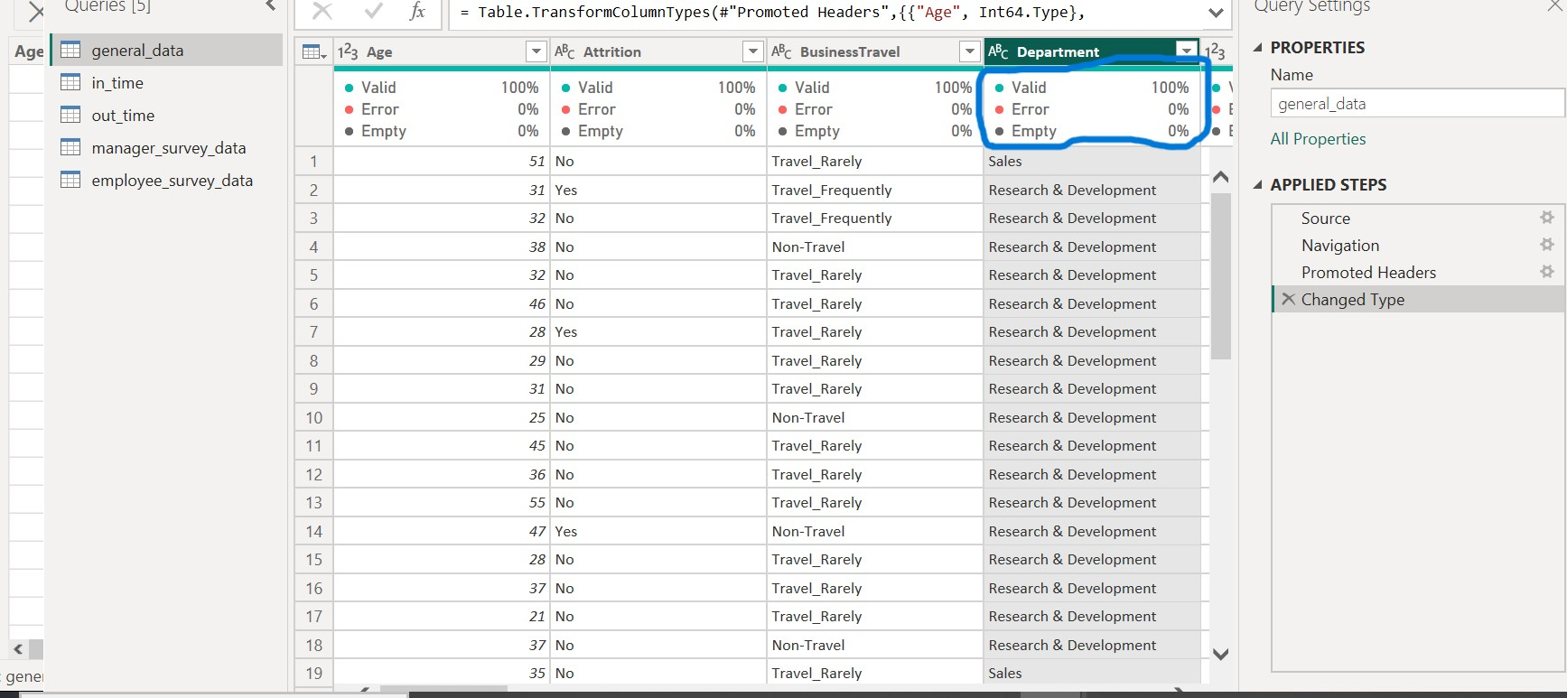
Identify and clean any missing or inconsistent data in the "Department" column.
There is no missing data in the “Department” column

Slide 11
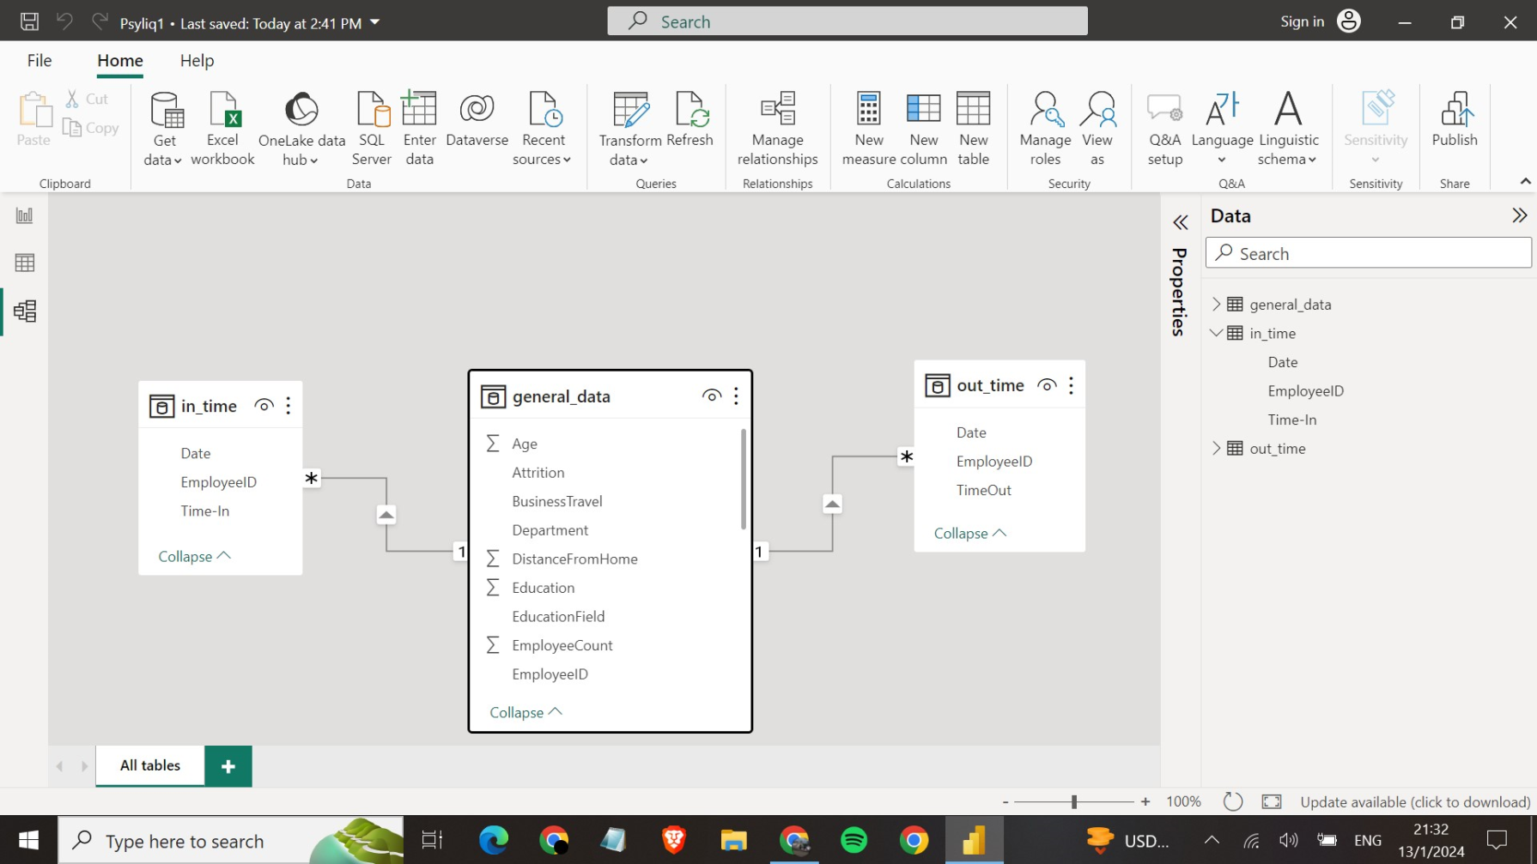
In Power BI, establish a relationship between the "EmployeeID" in the employee data and the "EmployeeID" in the time tracking data

Slide 12
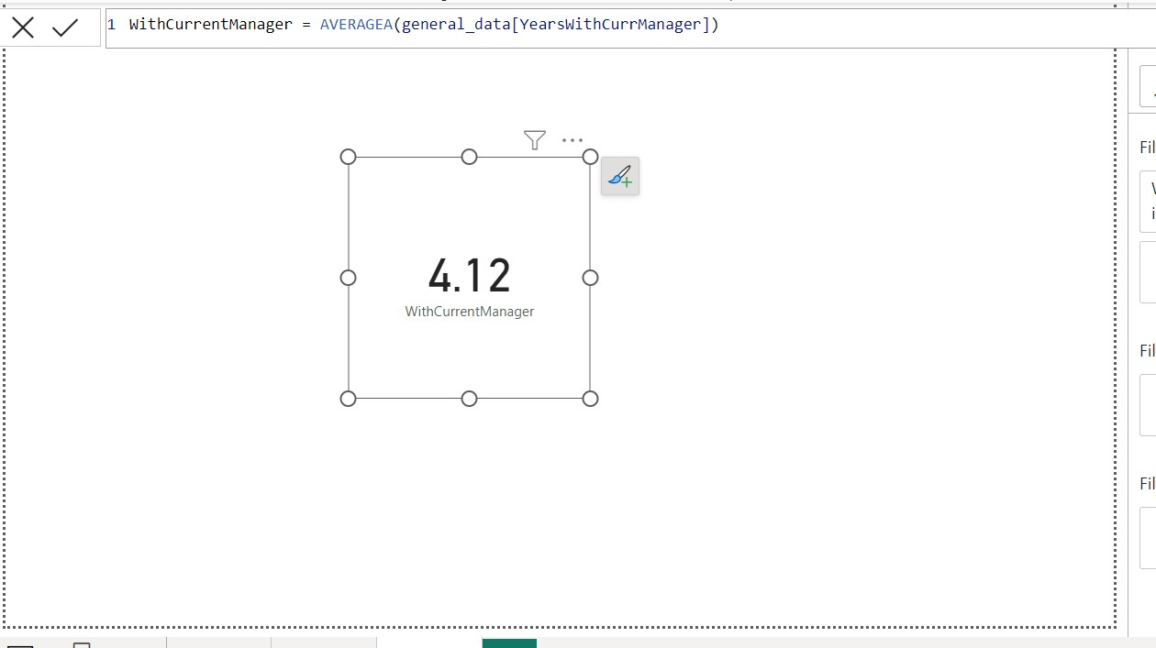
Using DAX, create a calculated column that calculates the average years an employee has spent with their current manager.

Slide 13
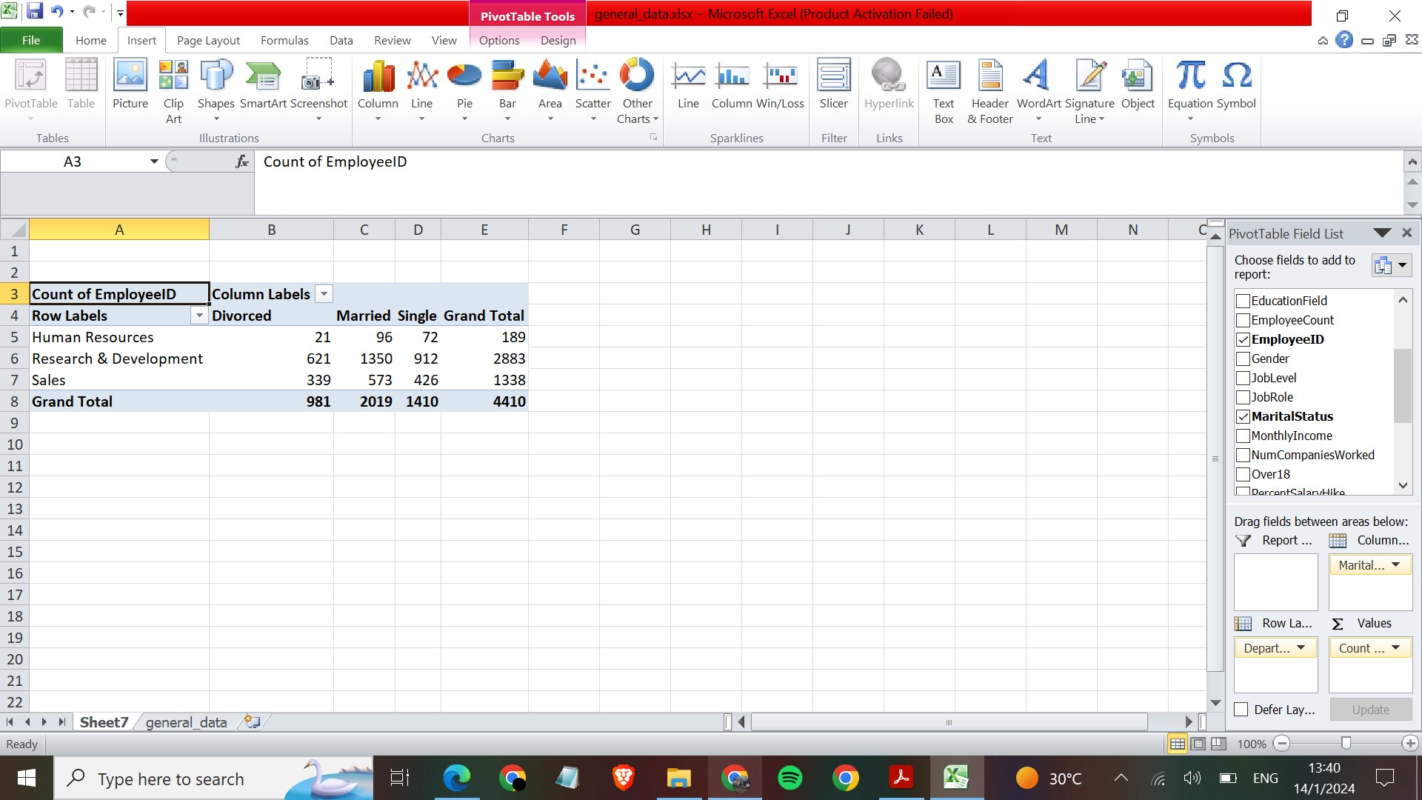
Using Excel, create a pivot table that displays the count of employees in each Marital Status category, segmented by Department.

Slide 14
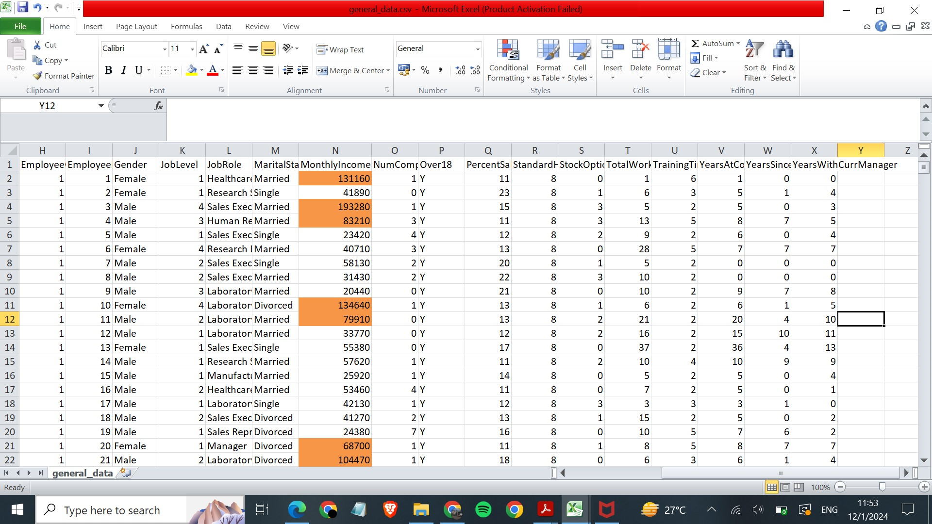
Apply conditional formatting to highlight employees with above-average Monthly Income.

Slide 15
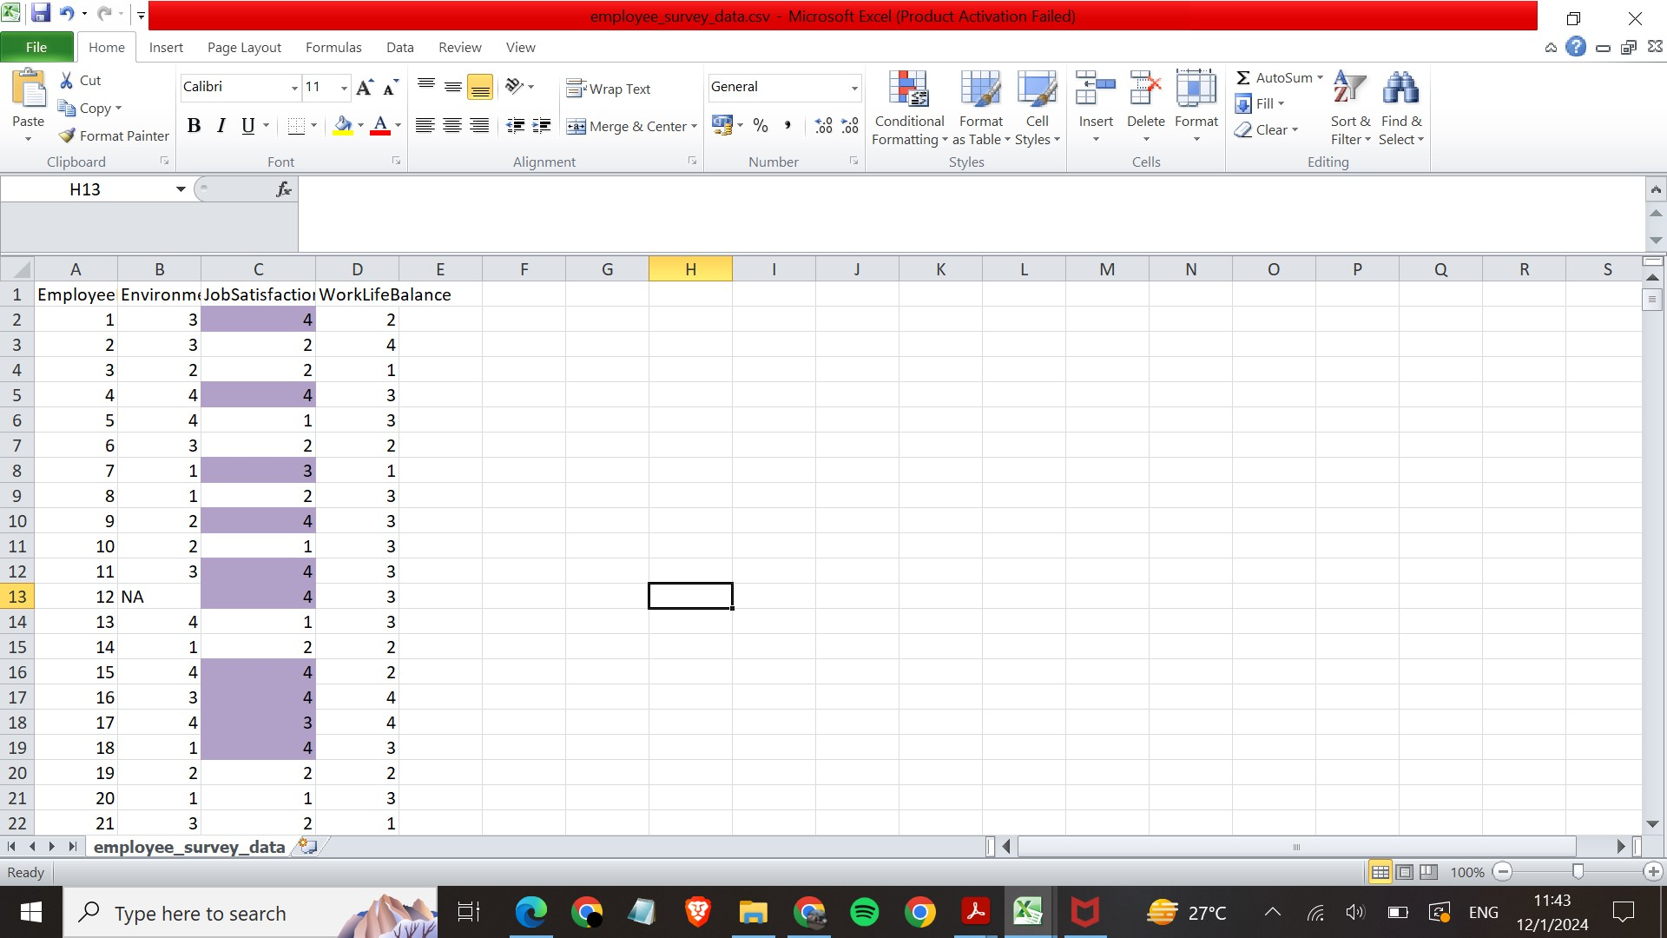
Apply conditional formatting to highlight employees with above-average Job Satisfaction.

Slide 16
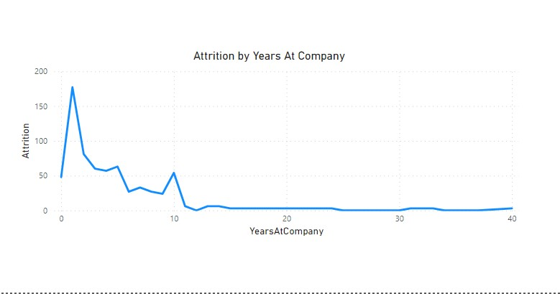
In Power BI, create a line chart that visualizes the trend of Employee Attrition over the years.

Slide 17
Describe how you would create a star schema for this dataset, explaining the benefits of doing so.
A star schema is a data warehouse design that organizes data into a central fact table and multiple dimension tables connected through foreign key relationships.
Using Power BI data modelling , star schema for the given data set can be created in which fact table would be general_data and dimension tables would be employee_survey ,manager_survey,in_time and out_time.
Benefits
The star schema design promotes optimal report performance by simplifying the structure, minimizing joins, supporting efficient aggregations, enabling proper indexing, leveraging parallel processing, offering scalability, and facilitating easier maintenance. These advantages make star schemas a popular choice for data warehousing and reporting applications.

Slide 18
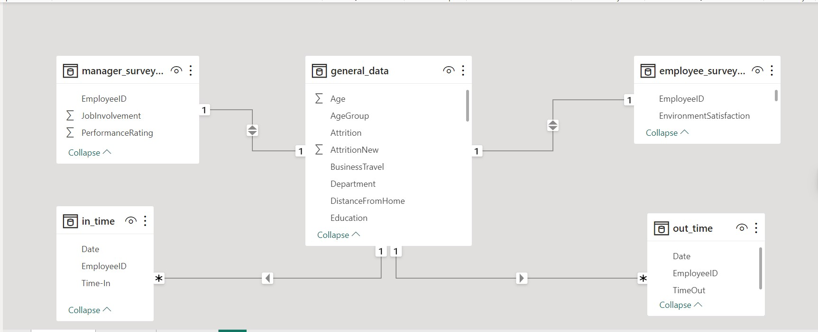

Slide 19
Create a hierarchy in Power BI that allows users to drill down from Department to Job Role to further narrow their analysis.
Select ’matrix’ from the ‘New visual’.
While using ’build a visual’ take [Department] and [JobRole] in the data fields of xaxis.
Take [AverageofMonthlyIncome] in the values field.
In the Drilldown feature one can observe monthly income in each Jobrole category by clicking on the downward arrow.

Slide 20
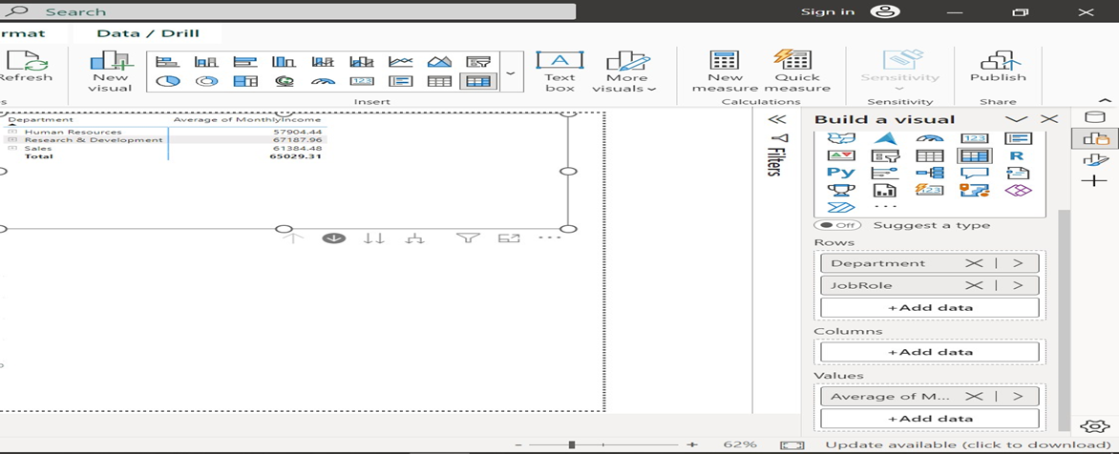

Slide 21
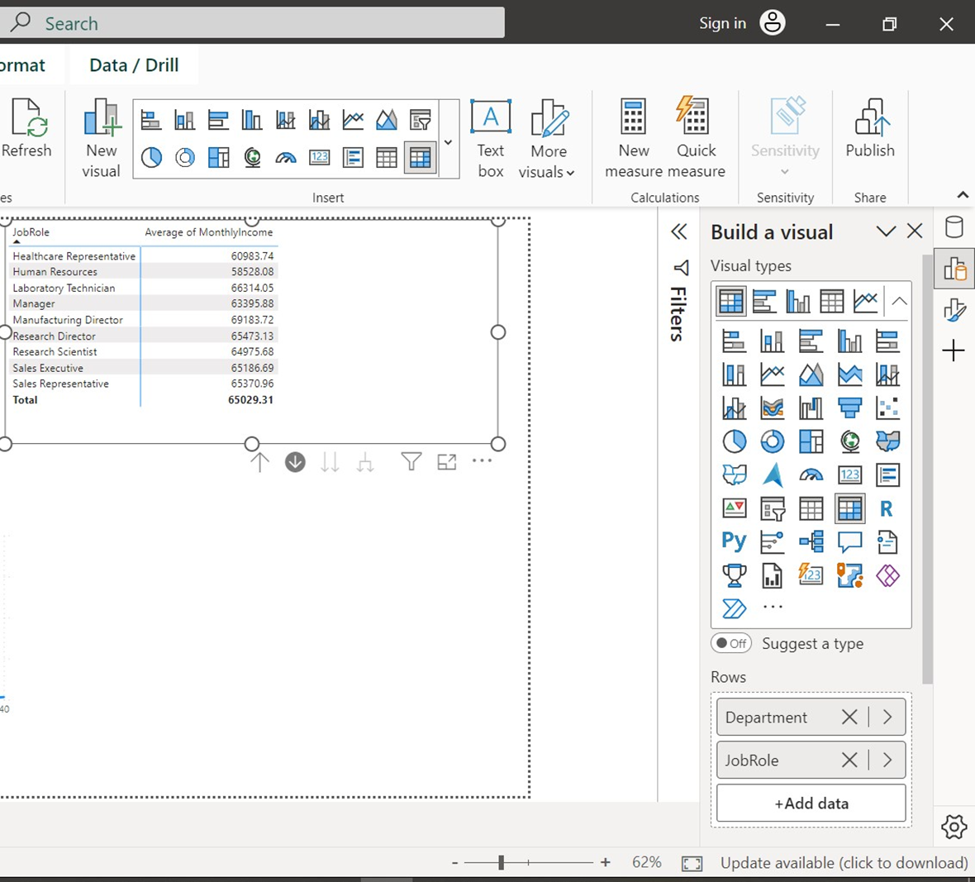

Slide 22
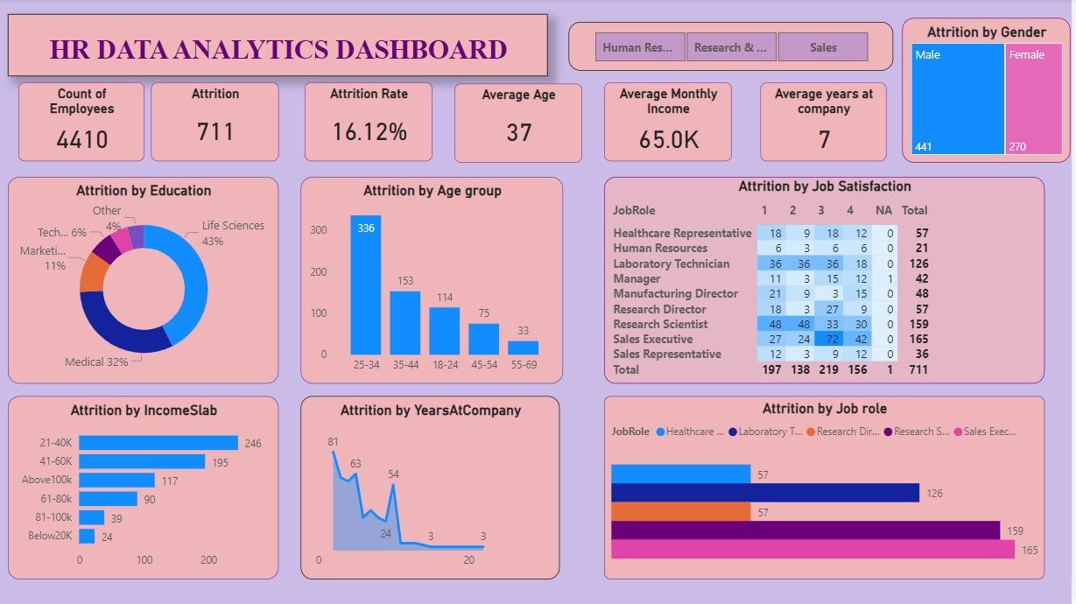

Slide 23
Insights from dashboard regarding Attrition
Of the total employees ie 4410, Attrition is 711 in which 441 are males and 270 are females.
Attrition is highest from the department Research and development and is 453.
Average monthly income of employees is 65K and the Attrition is highest (246) from the income slab (21-40K).
An employee spends an average of 7 years at company.
Attrition is highest (43%) of people from the Life Sciences background.
Attrition is highest (336) from the age group (25-34).
Attrition is highest (165) of the people in the Job Role of Sales Executive.

